Slide 1
Couchbase Java Workshop
Getting Started with the Couchbase Java SDK

Slide 2

About Me
Nic Raboy
Developer Advocate at Couchbase
@nraboy (Twitter)
Node.js, Android, Java, Ionic Framework, NoSQL, SQL

Slide 3
What Is Couchbase?

Slide 4
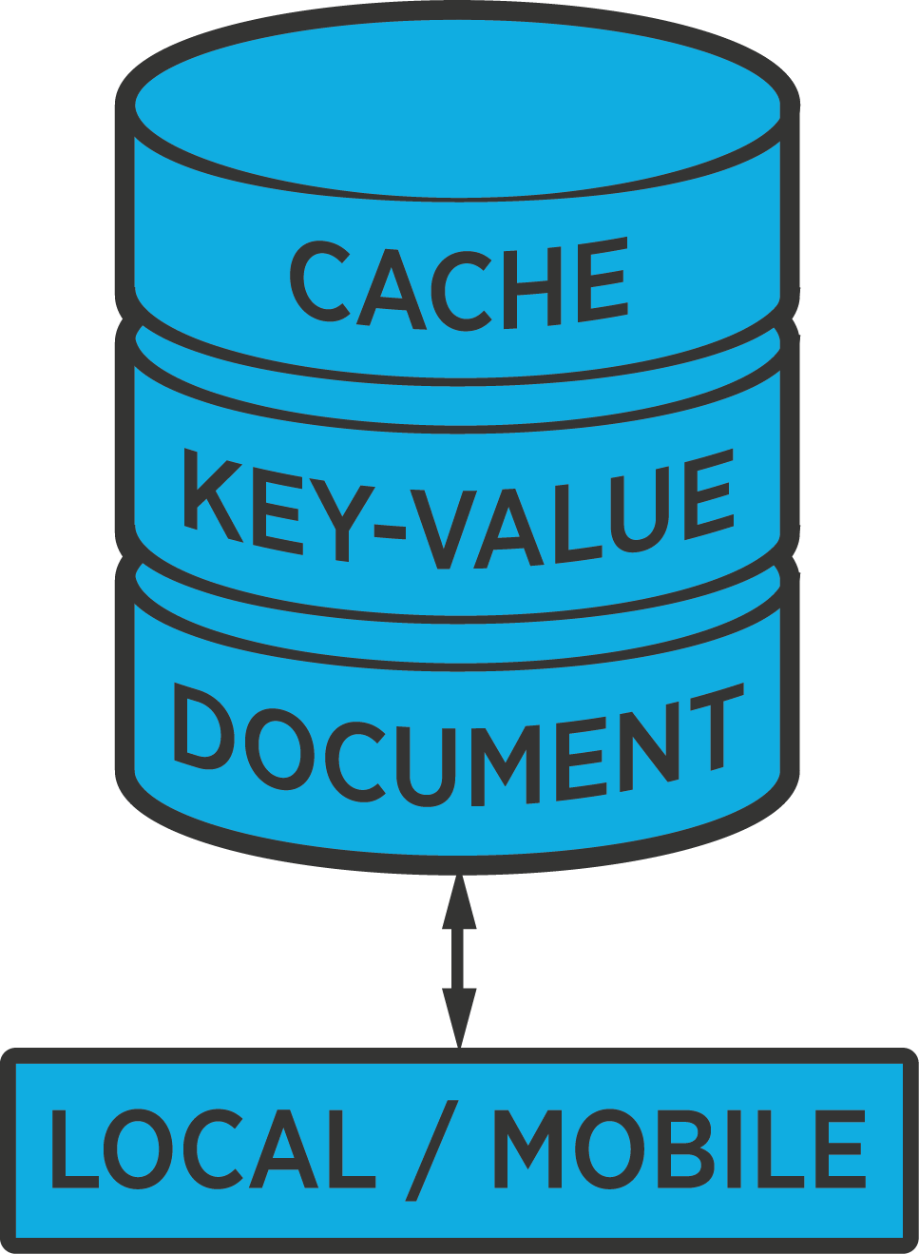

What makes Couchbase unique?
Enterprises choose Couchbase for several key advantages
24x365
Multi- purpose
Performance & scalability leader
Always-on availability
Simplified administration
Cache, key value store, document database, and local/mobile database in single platform
Sub millisecond latency with high throughput; memory-centric architecture
Data replication across nodes, clusters, and data centers
Easy to deploy & manage; integrated Admin Console, single-click cluster expansion & rebalance
Notes:
Couchbase has emerged as a leading NoSQL provider for number of reasons:
Best in performance and scalability
We’ve engineered Couchbase from the ground up for high performance and scalability
Couchbase is designed to deliver sub-millisecond responsiveness with very high throughput for both reads and writes
We consistently outperform competitors like MongoDB and DataStax in multiple independent benchmarks
Our performance advantage is driven in large part by our memory-centric architecture, which includes an integrated managed object cache and stream-based replication
Broad use case support
We’re the only NoSQL provider that has consolidated distributed cache, key-value store, and a JSON-based document database in a single platform
This means customers can use Couchbase for a much broader range of applications
Integrated mobile solution
We’re the only vendor that provides an end-to-end NoSQL mobile solution -- allows customers to easily build mobile apps that run great on or offline
Includes a JSON database embedded on the device, along with a prebuilt syncing tier
So apps run great on the device, even without a network connection or no connectivity at all
Data on the device auto-syncs with the backend server when a connection is available
Simplified administration
We’ve designed Couchbase to be exceptionally easy to deploy and manage
Features such as an integrated Admin Console and single-click cluster expansion & rebalance dramatically increase admin efficiency

Slide 5
Multi-purpose database supports many uses
Couchbase Lite
Tunable built-in cache
Flexible schemas with JSON
Consolidated cache and database
Tune memory required based on application requirements
Represent data with varying schemas using JSON on the server or on the device
Index and query data with Javascript views
Light weight embedded DB for always available apps
Sync Gateway syncs data seamlessly with Couchbase Server
5

Slide 6
Couchbase leads in performance and scalability
Auto Sharding
Memory-memory XDCR
Single Node Type
No manual sharding
Database manages data movement to scale out – not the user
Market’s only memory-to-memory database replication across clusters and geos
Provides disaster recover / data locality
Hugely simplifies management of clusters
Easy to scale clusters by adding any number of nodes

Slide 7

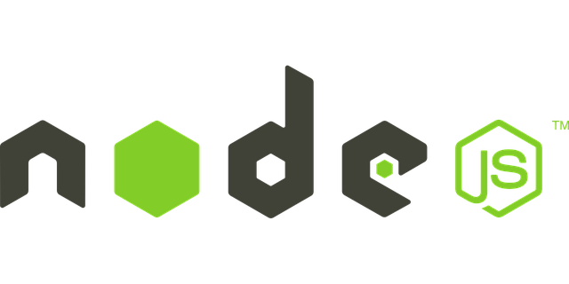



Available Couchbase Server SDKs
And more…

Slide 8
Overview of the Java SDK

Slide 9
Java SDK
Synchronous and asynchronous interfaces
Compatible with various Java frameworks
Spring, Dropwizard, Ratpack, etc.
Minimal coding
No database maintenance via code
No parsing queries via application code

Slide 10
Java Data Querying
Document operations
Couchbase views
N1QL queries

Slide 11
Bucket Operations
// CRUD Operations
import com.couchbase.client.java.*;
import com.couchbase.client.java.query.*;
import com.couchbase.client.java.document.*;
Cluster cluster = CouchbaseCluster.create(hostname);
Bucket bucket = cluster.openBucket(bucket, password);
JsonDocument document = bucket.get(key);
JsonDocument document = bucket.insert(oldDocument);
JsonDocument document = bucket.replace(oldDocument);
JsonDocument document = bucket.remove(oldDocument);

Slide 12
Java View Query
// Couchbase View
function (doc, meta) {
emit(meta.id, doc);
}
// Java Code
ViewResult result = bucket.query(ViewQuery.from("designdoc", "myview"));
for (ViewRow row : result) {
System.out.println(row);
}

Slide 13
Java N1QL Query
N1QL (pronounced "nickel") is the first query language that leverages the complete flexibility of JSON with the full power of SQL.
SELECT: retrieve documents via properties of existing docs
DELETE: provide the key to delete the document
INSERT: provide a key and some JSON to create a new document
UPSERT: as INSERT but will overwrite existing docs
UPDATE: change individual values inside existing docs

Slide 14
Java
// Instantiate The Query API
import com.couchbase.client.java.*;
import com.couchbase.client.java.query.*;
Cluster cluster = CouchbaseCluster.create(hostname);
Bucket bucket = cluster.openBucket(bucket, password);
N1qlQueryResult result = bucket.query(N1qlQuery.simple(“SELECT 1=1”));

Slide 15
Java
public List<Map<String, Object>> function(Bucket bucket) {
String query = "SELECT * FROM `" + bucket.name() + “`”;
N1qlQueryResult result = bucket.query(N1qlQuery.simple(query));
if (!result.finalSuccess()) {
throw new DataRetrievalFailureException("Query error: " + result.errors());
}
List<Map<String, Object>> content = new ArrayList<Map<String, Object>>();
for(N1qlQueryRow row : result) {
content.add(row.value().toMap());
}
return content;
}

Slide 16
Java
public List<Map<String, Object>> function(Bucket bucket) {
String query = "SELECT * FROM `" + bucket.name() + “`”;
N1qlQueryResult result = bucket.query(N1qlQuery.simple(query));
if (!result.finalSuccess()) {
throw new DataRetrievalFailureException("Query error: " + result.errors());
}
List<Map<String, Object>> content = new ArrayList<Map<String, Object>>();
for(N1qlQueryRow row : result) {
content.add(row.value().toMap());
}
return content;
}

Slide 17
Java
public List<Map<String, Object>> function(Bucket bucket) {
String query = "SELECT * FROM `" + bucket.name() + “`”;
N1qlQueryResult result = bucket.query(N1qlQuery.simple(query));
if (!result.finalSuccess()) {
throw new DataRetrievalFailureException("Query error: " + result.errors());
}
List<Map<String, Object>> content = new ArrayList<Map<String, Object>>();
for(N1qlQueryRow row : result) {
content.add(row.value().toMap());
}
return content;
}

Slide 18
Java
public List<Map<String, Object>> function(Bucket bucket) {
String query = "SELECT * FROM `" + bucket.name() + “`”;
N1qlQueryResult result = bucket.query(N1qlQuery.simple(query));
if (!result.finalSuccess()) {
throw new DataRetrievalFailureException("Query error: " + result.errors());
}
List<Map<String, Object>> content = new ArrayList<Map<String, Object>>();
for(N1qlQueryRow row : result) {
content.add(row.value().toMap());
}
return content;
}

Slide 19
Java
public List<Map<String, Object>> function(Bucket bucket) {
String query = "SELECT * FROM `" + bucket.name() + “`”;
N1qlQueryResult result = bucket.query(N1qlQuery.simple(query));
if (!result.finalSuccess()) {
throw new DataRetrievalFailureException("Query error: " + result.errors());
}
List<Map<String, Object>> content = new ArrayList<Map<String, Object>>();
for(N1qlQueryRow row : result) {
content.add(row.value().toMap());
}
return content;
}

Slide 20
Java
public List<Map<String, Object>> function(Bucket bucket) {
String query = "SELECT * FROM `" + bucket.name() + “`”;
N1qlQueryResult result = bucket.query(N1qlQuery.simple(query));
if (!result.finalSuccess()) {
throw new DataRetrievalFailureException("Query error: " + result.errors());
}
List<Map<String, Object>> content = new ArrayList<Map<String, Object>>();
for(N1qlQueryRow row : result) {
content.add(row.value().toMap());
}
return content;
}

Slide 21
Java
public List<Map<String, Object>> function(Bucket bucket) {
String query = "SELECT * FROM `" + bucket.name() + “`”;
N1qlQueryResult result = bucket.query(N1qlQuery.simple(query));
if (!result.finalSuccess()) {
throw new DataRetrievalFailureException("Query error: " + result.errors());
}
List<Map<String, Object>> content = new ArrayList<Map<String, Object>>();
for(N1qlQueryRow row : result) {
content.add(row.value().toMap());
}
return content;
}

Slide 22
Demo Time!

Slide 23
Java Application Design
AngularJS
Client Frontend
Java
Server Backend

Slide 24
Java Separation of Frontend and Backend
API driven
Less client and server coupling
The backend can evolve without affecting the frontend
Frontend can be extended to web as well as mobile

Slide 25




Multiple Frontends & One Backend

Slide 26
The Java Backend

Slide 27
Java Configuration
// application.properties
hostname=127.0.0.1
bucket=restful-sample
password=

Slide 28
Java Create or Update Endpoint
// Application.java
@RequestMapping(value="/save", method=RequestMethod.POST)
public Object save(@RequestBody String json) {
JsonObject jsonData = JsonObject.fromJson(json);
if(jsonData.getString("firstname") == null || jsonData.getString("firstname").equals("")) {
return new ResponseEntity<String>(JsonObject.create().put("message", "A firstname is
required").toString(), HttpStatus.BAD_REQUEST);
}
// Other parameter validation here…
return Database.save(bucket, jsonData);
}

Slide 29
Java Get Document Endpoint
// Application.java continued…
@RequestMapping(value="/get", method= RequestMethod.GET)
public Object getByDocumentId(@RequestParam String document_id) {
if(document_id.equals("")) {
return new ResponseEntity<String>(JsonObject.create().put("message", "A document id is
required").toString(), HttpStatus.BAD_REQUEST);
}
return Database.getByDocumentId(bucket, document_id);
}

Slide 30
Java Delete Endpoint
// Application.java continued…
@RequestMapping(value="/delete", method=RequestMethod.POST)
public Object delete(@RequestBody String json) {
JsonObject jsonData = JsonObject.fromJson(json);
if(jsonData.getString("document_id") == null || jsonData.getString("document_id").equals("")) {
return new ResponseEntity<String>(JsonObject.create().put("message", "A document id is
required").toString(), HttpStatus.BAD_REQUEST);
}
return Database.delete(bucket, jsonData.getString("document_id"));
}

Slide 31
Java Extract Result
// Database.java
private static List<Map<String, Object>> extractResultOrThrow(N1qlQueryResult result) {
if (!result.finalSuccess()) {
throw new DataRetrievalFailureException("Query error: " + result.errors());
}
List<Map<String, Object>> content = new ArrayList<Map<String, Object>>();
for (N1qlQueryRow row : result) {
content.add(row.value().toMap());
}
return content;
}

Slide 32
Java Upsert Document Function
// Database.java
public static List<Map<String, Object>> save(final Bucket bucket, JsonObject data) {
String documentId = !data.getString("document_id").equals("") ? data.getString("document_id") :
UUID.randomUUID().toString();
String queryStr = "UPSERT INTO `" + bucket.name() + "` (KEY, VALUE) VALUES " +
"($1, {'firstname': $2, 'lastname': $3, 'email': $4})";
JsonArray parameters = JsonArray.create()
.add(documentId)
.add(data.getString("firstname"))
.add(data.getString("lastname"))
.add(data.getString("email"));
ParameterizedN1qlQuery query = ParameterizedN1qlQuery.parameterized(queryStr, parameters);
N1qlQueryResult queryResult = bucket.query(query);
return extractResultOrThrow(queryResult);
}

Slide 33
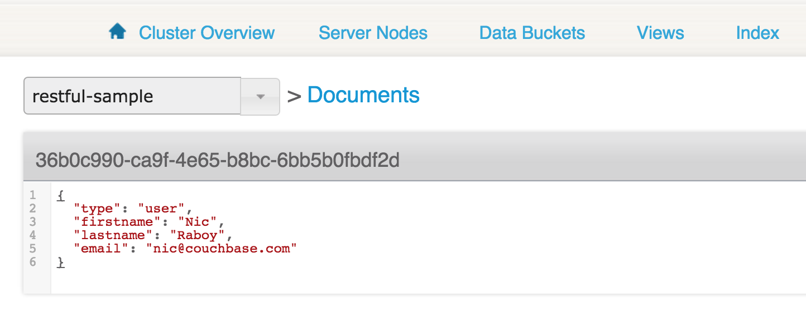
Couchbase JSON Document

Slide 34
Java Get Document with N1QL Function
// Database.java continued…
public static List<Map<String, Object>> getByDocumentId(final Bucket bucket, String documentId) {
String queryStr = "SELECT firstname, lastname, email " +
"FROM `" + bucket.name() + "` AS users " +
"WHERE META(users).id = $1";
ParameterizedN1qlQuery query = ParameterizedN1qlQuery.parameterized(queryStr,
JsonArray.create().add(documentId));
N1qlQueryResult queryResult = bucket.query(query);
return extractResultOrThrow(queryResult);
}

Slide 35
Java Delete Document Function
// Database.java continued…
public static List<Map<String, Object>> delete(final Bucket bucket, String documentId) {
String queryStr = "DELETE " +
"FROM `" + bucket.name() + "` AS users " +
"WHERE META(users).id = $1";
ParameterizedN1qlQuery query = ParameterizedN1qlQuery.parameterized(queryStr,
JsonArray.create().add(documentId));
N1qlQueryResult queryResult = bucket.query(query);
return extractResultOrThrow(queryResult);
}

Slide 36
The AngularJS Frontend

Slide 37
// AngularJS app.js
$scope.fetchAll = function() {
$http(
{
method: "GET",
url: "/api/getAll"
}
)
.success(function(result) {
for(var i = 0; i < result.length; i++) {
$scope.items[result[i].id] = result[i];
}
});
}

Slide 38
// AngularJS app.s
$scope.save = function(firstname, lastname, email) {
$http(
{
method: "POST",
url: "/api/create",
data: {
firstname: firstname,
lastname: lastname,
email: email,
document_id: $stateParams.documentId
}
}
)
}

Slide 39
Simple Java Project GitHub
https://github.com/couchbaselabs/restful-angularjs-java

Slide 40
RxJava and the Asynchronous API

Slide 41
RxJava and the Asynchronous API
Observable<T> and Observer<T>
Observables are streams of data
Rx operators manipulate the data stream

Slide 42
Observable<T> Operators
Transformations
Filtering
Combinations
Managing Errors

Slide 43
Observable<T> Transformation
Observable<T> source
Observable<R> target = source.map(mapFunction)
mapFunction transforms each T into an R
Ex: T = String and R = int

Slide 44
Observable<T> Filter
Observable<T> filter ( filterPredicate )
Only emit T’s that match the filterPredicate

Slide 45
RxJava Example
return bucket.async()
.get("user::" + username)
.map(new Func1<JsonDocument, ResponseEntity<String>>() {
@Override
public ResponseEntity<String> call(JsonDocument doc) {
return new ResponseEntity<String>(doc.content().getArray("flights").toString(), HttpStatus.OK);
}
})
.defaultIfEmpty(new ResponseEntity<String>("{failure: 'No flights found'}", HttpStatus.OK))
.toBlocking()
.single();

Slide 46
RxJava Example
// Async Query
bucket.query(Query.simple(select(“*”).from(i(“bucket-name”)).limit(10)))
.flatMap(AsyncQueryResult::row)
.forEach(System.out::println);
// Result
{ data: { something: “1” }
{ data: { something: “2” }
// …

Slide 47
Couchbase N1QL Tutorial
http://query.pub.couchbase.com/tutorial

Slide 48
Questions?

Slide 49
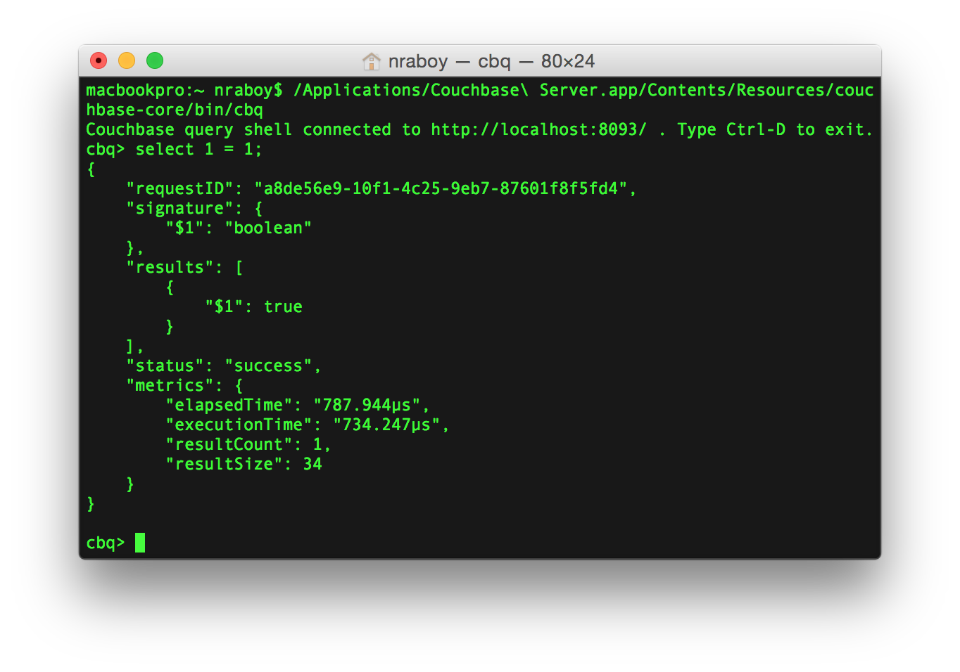
Couchbase Query (CBQ) Client

Slide 50
Travel Application
Workshop

Slide 51
The Data Model
{
"callsign": "UNITED",
"country": "United States",
"iata": "UA",
"icao": "UAL",
"id": 5209,
"name": "United Airlines",
"type": "airline"
}
{
"airportname": "Heathrow",
"city": "London",
"country": "United Kingdom",
"faa": "LHR",
"geo": {
"alt": 83,
"lat": 51.4775,
"lon": -0.461389
},
"icao": "EGLL",
"id": 507,
"type": "airport",
"tz": "Europe/London"
}
{
"airline": "UA",
"airlineid": "airline_5209",
"destinationairport": "SFO",
"equipment": "777",
"id": 57047,
"schedule": [
{
"day": 0,
"flight": "UA894",
"utc": "02:32:00" },
...
],
"sourceairport": "LHR",
"stops": 0,
"type": "route"
}
Notes:
Let's look at some sample docs from the travel sample.

Slide 52
Workshop URL
https://github.com/couchbaselabs/couchbase-java-workshop

Slide 53
Workshop Files and Directories
finished
initial
images
README.md

Slide 54
Workshop Steps
Connect to a Couchbase Cluster and Open a Bucket
Standard NoSQL CRUD Operations
RxJava and the Couchbase SDK
SQL-like Queries with Couchbase N1QL
Creating API Endpoints

Slide 55
Demo
The Travel Sample

Slide 56
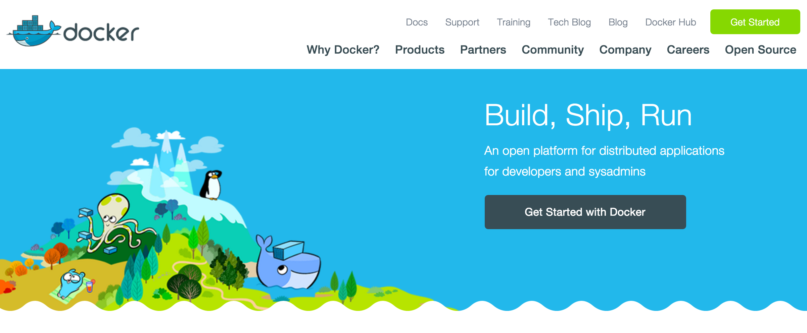
Getting Started with Docker

Slide 57
New Docker Containers
docker run –d –p 1337:8091 couchbase
docker run –d –p 1338:8091 couchbase
docker-machine ip default
docker network ls
docker network inspect 53fe76

Slide 58
Couchbase Query Client (CBQ)
./Applications/Couchbase\ Server.app/Contents/Resources/couchbase-core/bin/cbq
C:/Program Files/Couchbase/Server/bin/cbq.exe

